Slide 1


How has COVID-19 Impacted the Development of
?
Guideline Portfolio Project - DQLab

Slide 2

Rica Kesuma Mansyur
Data Analyst

Slide 3
Our company
AirBnb is an American San Francisco-based company operating an online marketplace for short- and long-term homestays and experiences. The company acts as a broker and charges a commission from each booking. The company was founded in 2008 by Brian Chesky, Nathan Blecharczyk, and Joe Gebbia. Airbnb is a shortened version of its original name, AirBedandBreakfast.com. The company is credited with revolutionizing the tourism industry, while also having been the subject of intense criticism by residents of tourism hotspot cities like Barcelona and Venice for enabling an unaffordable increase in home rents, and for a lack of regulation

Slide 4

Business Decision
DQLab as a data company received a client request from Singapore. The prospective property owner will be renting out the property on the Airbnb marketplace and wants to get the maximum profit from his property rental. Previously, it has been known that the right rental place influences the high rental activity.

Slide 5
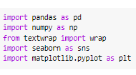
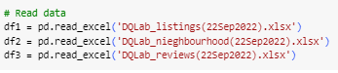
Import & Read Data
Check
Python
Here
Check
Github
Here
Check
Dataset
Here
1. Import Packages
2. Read Data

Slide 6
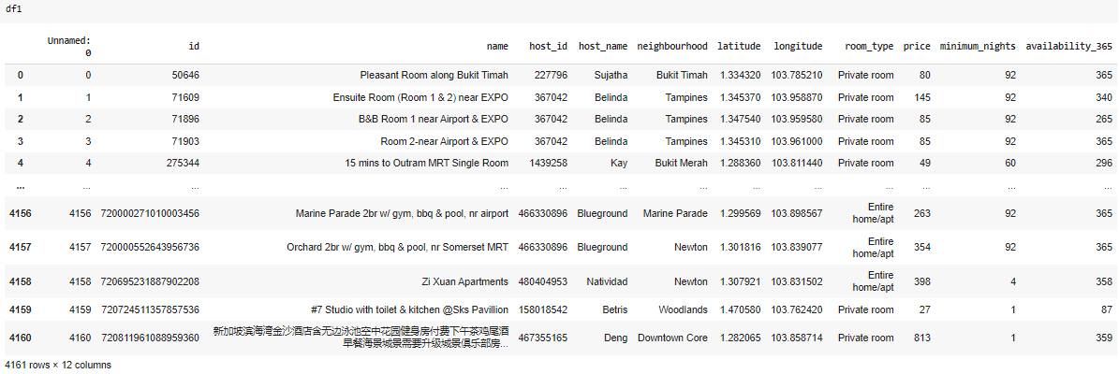
First Step
df1
file
DQLab_Listing

Slide 7
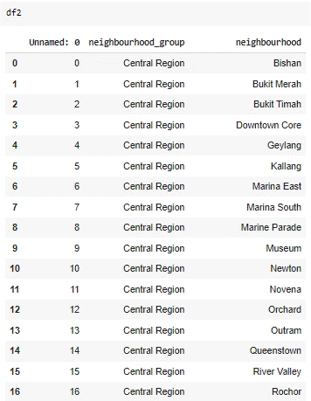
df2
file
DQLab_neighbourhood

Slide 8
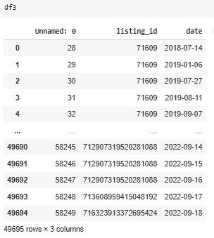
df3
file
DQLab_reviews

Slide 9
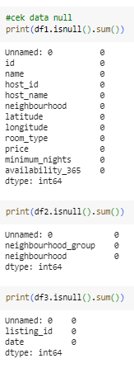
Check Missing Values
Missing Values: 0

Slide 10
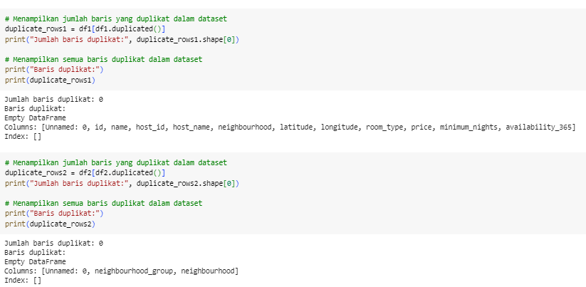
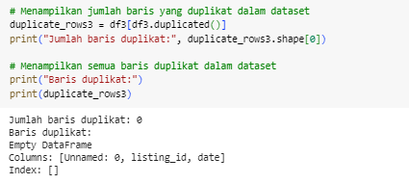
Check Duplicate
Duplicate: 0

Slide 11
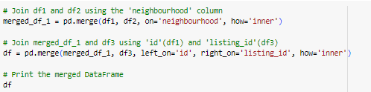
Merge 3 Tables
Fonts | To view this template correctly in PowerPoint, download and install the fonts we used
Used and alternative resources | An assortment of graphic resources that are suitable for use in this presentation
Thanks slide | You must keep it so that proper credits for our design are given
Colors | All the colors used in this presentation
Icons and infographic resources | These can be used in the template, and their size and color can be edited
Editable presentation theme | You can edit the master slides easily. For more info, click here

Slide 12
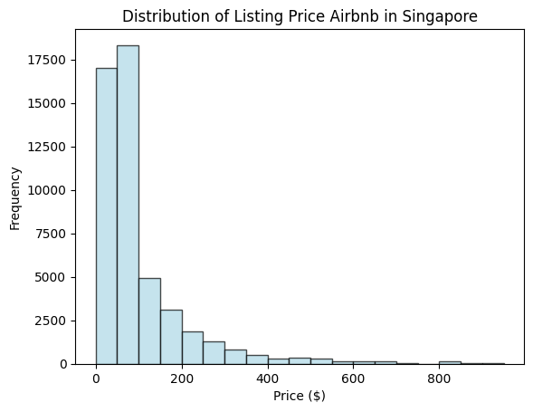
Distribution of Listing Price AirBnb in Singapore

Slide 13
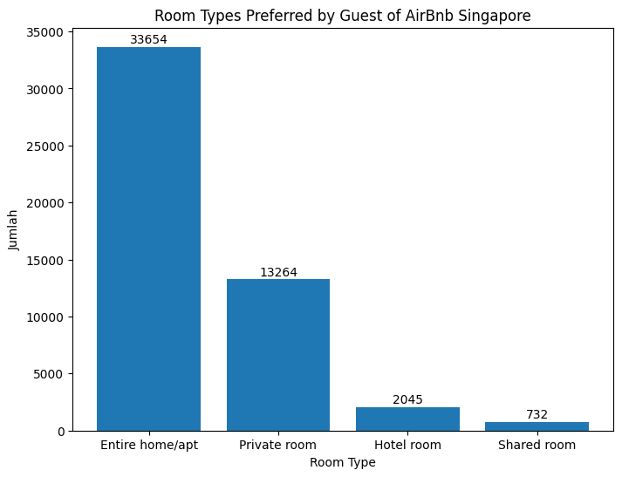
Room Types Preferred by Guest of Airbnb Singapore

Slide 14
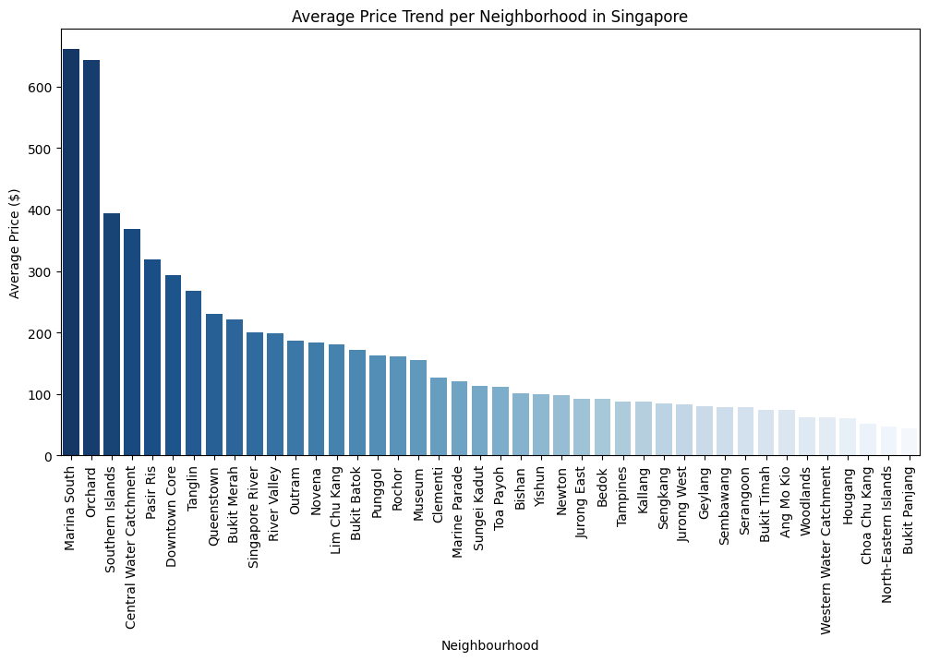
Average Price Trend per Neighborhood in Singapore

Slide 15
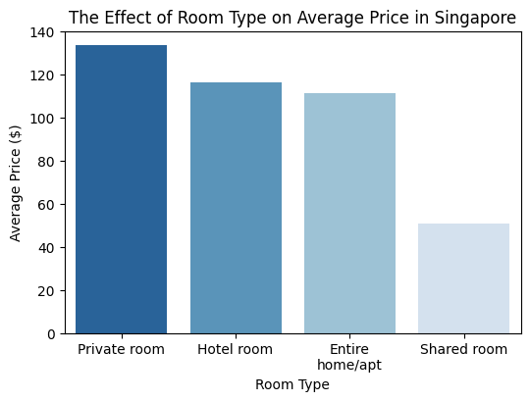
The Effect of Room Type on Average Price in Singapore

Slide 16
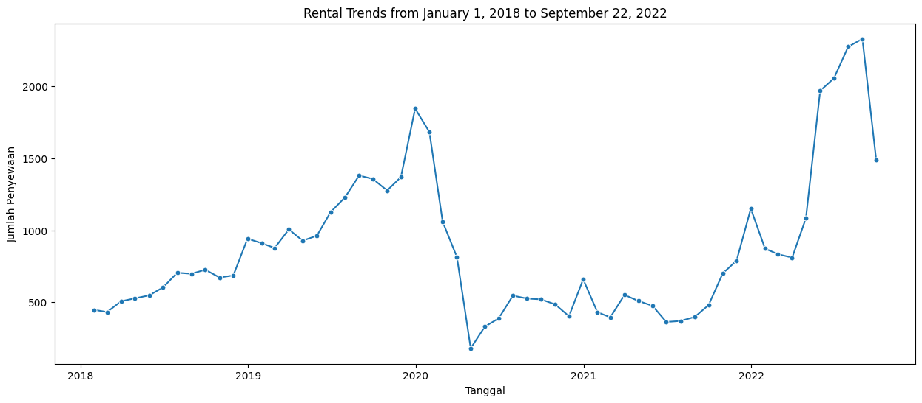
Rental Trends from January 1, 2018 – September 22, 2022

Slide 17
Rental Trends from January 1, 2018 – September 22, 2022
Decreased very drastically even better than 2018-2019 because of better strategies
Stable Increase Rent Room
2018-2019
2022
2020-2021
Decreased very drastically because of
COVID-19

Slide 18
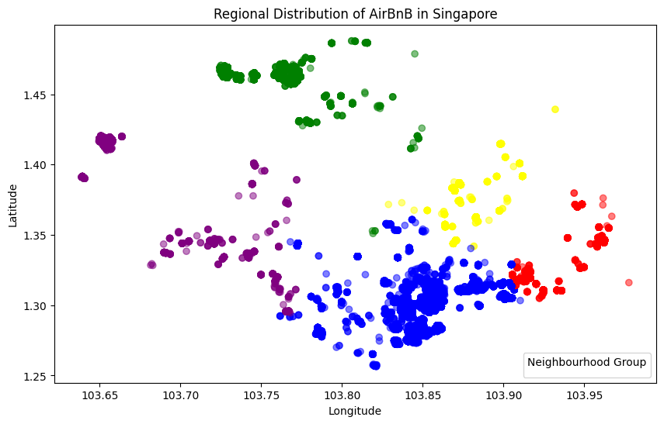
Regional Distribution of AirBnb in Singapore
Info:
Central Region
East Region
North Region
North-East Region
West Region

Slide 19
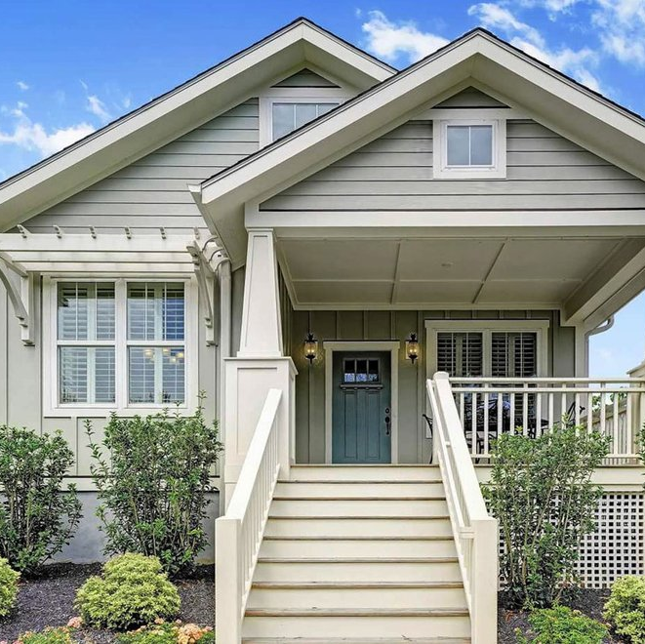
Conclusion
The COVID-19 pandemic brought an unprecedented decline in Airbnb's room rental business, as global travel restrictions and health concerns left many travelers hesitant to book stays. During the height of the pandemic, the company saw a significant slump in bookings. However, as the world transitioned into the new normal phase, Airbnb's fortunes started to rebound. The CEO's strategic response, including implementing strict sanitation protocols, offering flexible cancellation policies, and focusing on local travel experiences, played a crucial role in restoring customer confidence. These strategies not only helped to mitigate the initial drop but also allowed Airbnb to tap into new market opportunities, resulting in a resurgence of bookings. The company's ability to adapt and innovate in the face of crisis is a testament to its resilience and positions it well for future growth in the ever-changing travel industry.

Slide 20
Thank You!
DO YOU HAVE ANY QUESTIONS?
rica.kesuma6@gmail.com
+62 852 8033 6465
Github / Linkedin
Please keep this slide for attribution

